Slide 1
Refactoring
Yuqun Zhang
CS 304

Slide 2
What is Refactoring?
Semantic-preserving program transformations
A change made to the internal structure of a program without modifying its observable behavior to make it
Easier to understand
Cheaper to modify
Refactoring patterns
“Improving the design after the code has been written”
Seems a bit odd since we usually design first then code
Refactoring usually entails small changes with large cumulative effects

Slide 3
Why Refactor?
Code degenerates under maintenance
Code was poorly written to begin with

Slide 4
Bad Code Smells and Refactoring
Code smells
Indicative of bad software design
List of bad smells: http://blog.codinghorror.com/code-smells/
Useful “catalog” of refactorings: http://www.refactoring.com/catalog/
Mapping of smells to refactorings: http://www.industriallogic.com/wp-content/uploads/2005/09/smellstorefactorings.pdf

Slide 5
Refactorings
The book is basically a catalog of common refactoring patterns
Each includes a name, summary, motivation, mechanics, and examples
Not formal (they can’t be, since determining program equivalence is undecidable)
Similar in nature to design patterns
Defining a shared vocabulary

Slide 6
Examples of Code Smells
And associated refactorings

Slide 7

#1: Duplicated Code
You’ve done this before
You know it’s bad
Examples
Same expression in two methods in the same class
Same expression in two methods in sibling classes
Same expression in two unrelated classes
Explicit and subtle duplication
E.g., identical code (explicit) vs. structures or processing steps that appear different but are essentially the same (subtle)
Potential useful refactorings:
Extract method, Extract class, Template method pattern, Strategy pattern

Slide 8
Extract Method
Applies when you have a code fragment inside some code blocks where the lines of code should always be grouped together
Turn the fragment into a method whose name explains the purpose of the block of code

Slide 9
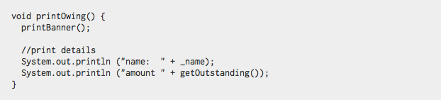

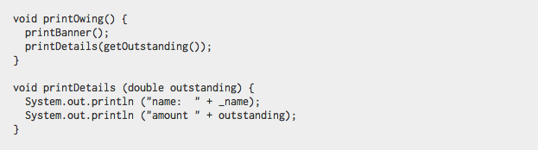
Extract Method Refactoring Example

Slide 10
Extract Class
You have one class doing work that should be done by two different classes
Create a new class and move the relevant fields and methods from the old class to the new class

Slide 11
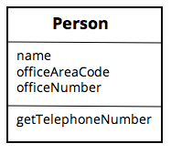
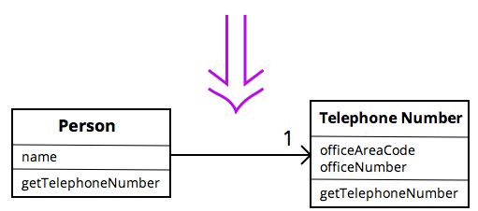
Extract Class Example

Slide 12
Some codes
class Person...
private String name;
private TelephoneNumber officeTelephone = new TelephoneNumber();
public String getName(){
return name;
}
public String getTelephoneNumber(){
return officeTelephone.getTelephoneNumber();
}

Slide 13
Some codes (continued.)
class TelephoneNumber...
private String number;
private String areacode;
public String getTelephoneNumber(){
return (“(“ + areacode + “) ” + number);
}

Slide 14
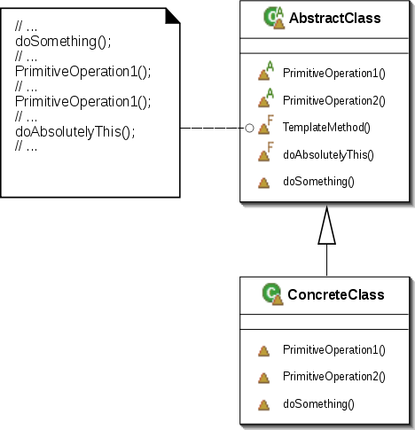
Template Method Pattern
A Template Method describes the skeleton behavior of a method
Defers some substeps to subclasses
By defining the “primitive operations” comprising the template method, the subclasses provide different behaviors

Slide 15

Style Smells
Comments
There’s a fine line between comments that illuminate and comments that obscure
Make sure comments are actually needed; if possible, refactor the code so that the comments aren’t required
Copious comments can be indicative of bad code
Naming
Avoid placing types in method or variable names (because if you change the type, you’ll have to change the name)
Make sure that the names of methods and variables succinctly describe what the purpose is
Pick a standard way of naming things and stick with it; make sure that analog functions have analog names (e.g., if you can open() you ought to be able to close())
Dead code
Delete it. Use version control.

Slide 16

Long Method
Two long methods are more likely to share duplicated code/logic
Small methods help explain code
If you don’t understand a long method, breaking it into smaller, well named methods helps readability
Systems with smaller methods tend to be easier to extend and maintain
Summary: all other things being equal, a shorter method is easier to read, easier to understand, and easier to troubleshoot
Potential useful refactorings:
Extract method (vast majority of the time)

Slide 17

Large Class
This often happens when we code before careful design or prototype a design and then keep building it
Too many instance variables
A class is trying to do too much
The class has too many responsibilities
Single Responsibility Principle: one class should be responsible for only one functional purpose
Potential refactorings
Extract class, Extract subclass
Hint: look for common prefixes/suffixes in identifiers
Observer
Common for GUIs

Slide 18

Long Parameter List
Long lists of parameters (common in procedural programming) are likely to be volatile
i.e., likely to change often and rapidly
Consider which parameters are essential
Leave the rest to the object to track down as necessary
Potential refactorings:
Replace parameter with method, Introduce parameter object, Preserve whole object

Slide 19
Replace Parameter with Method
An object invokes a method then passes the result as a parameter for a method
The receiver can also invoke this method
Why the indirection? Remove the parameter and let the receiver invoke the method.

Slide 20
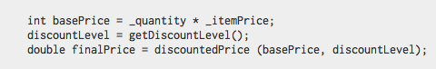

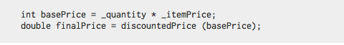
Replace Parameter with Method Example

Slide 21
Some codes (originally)
public double getPrice(){
int basePrice = quantity * itemPrice;
int discountLevel;
if (quantity > 100) discountLevel = 2;
else discountLevel = 1;
double finalPrice = discoutedPrice (basePrice, discountLevel);
return finalPrice;
}
private double discountedPrice (int basePrice, int discountLevel) {
if (discountLevel == 2) return basePrice * 0.1;
else return basePrice * 0.05;
}

Slide 22
Some codes (originally)
public double getPrice(){
int basePrice = quantity * itemPrice;
int discountLevel;
if (quantity > 100) discountLevel = 2;
else discountLevel = 1;
double finalPrice = discoutedPrice (basePrice, discountLevel);
return finalPrice;
}
private double discountedPrice (int basePrice, int discountLevel) {
if (discountLevel == 2) return basePrice * 0.1;
else return basePrice * 0.05;
}

Slide 23
Some codes (Initial modification)
public double getPrice(){
int basePrice = quantity * itemPrice;
int discountLevel = getDiscountLevel();
double finalPrice = discoutedPrice (basePrice, discountLevel);
return finalPrice;
}
private int getDiscountLevel () {
if (quantity > 100) discountLevel = 2;
else discountLevel = 1;
}

Slide 24
Some codes (a little further)
private double discountedPrice (int basePrice, int discountLevel) {
if (getDiscountLevel() == 2) return basePrice * 0.1;
else return basePrice * 0.05;
}

Slide 25
Some codes (Now what do we have)
public double getPrice(){
int basePrice = quantity * itemPrice;
int discountLevel = getDiscountLevel();
double finalPrice = discoutedPrice (basePrice);
return finalPrice;
}
private double discountedPrice (int basePrice) {
if (getDiscountLevel() == 2) return basePrice * 0.1;
else return basePrice * 0.05;
}

Slide 26
Some codes (Something is not necessary)
public double getPrice(){
int basePrice = quantity * itemPrice;
int discountLevel = getDiscountLevel();
double finalPrice = discoutedPrice (basePrice);
return finalPrice;
}
private double discountedPrice (int basePrice) {
if (getDiscountLevel() == 2) return basePrice * 0.1;
else return basePrice * 0.05;
}

Slide 27
Some codes (final version)
public double getPrice(){
return discountedPrice();
}
private double discountedPrice () {
if (getDiscountLevel() == 2) return getBasePrice() * 0.1;
else return getBasePrice() * 0.05;
}
private double getBasePrice(){
return quantity * itemPrice;
}

Slide 28
Introduce Parameter Object
You have a group of parameters that naturally (often) go together
Replace them with a single object

Slide 29
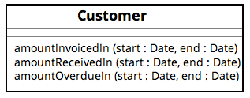

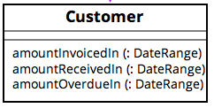
Introduce Parameter Object Example

Slide 30
Preserve Whole Object
You get a bunch of values from an object but then pass those objects together to another method call
Maybe you should just pass the whole object instead.

Slide 31
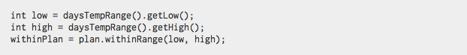

Preserve Whole Object Example

Slide 32

Divergent Change
Commonly change a particular class in different ways for different reasons
Separating divergent responsibilities decreases the chance that one change negatively affects a different function
E.g., in class X, change mA(), mB(), and mC() every time we add a new database; change mD(), mE(), and mF() every time we add a new financial instrument
Potential refactoring:
Extract class

Slide 33

Shotgun Surgery
Opposite of divergent change
One change alters many classes; constantly making lots of little changes to a lot of different classes
It’s easy to miss an important change
Special case:
Parallel inheritance hierarchies – every time you make a subclass of one class, you have to make a subclass of another
Potential refactorings:
Move method, Move field, Inline class

Slide 34
Move Method
A method is, or will be, using or used by more features of a class other than the class within which it is defined
Well, then, move it. Create a new method with a similar body in the class it uses most. Turn the old method into a simple delegation or remove it altogether.

Slide 35
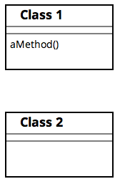
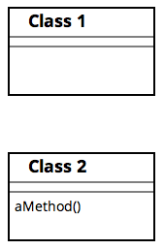

Move Method Example

Slide 36
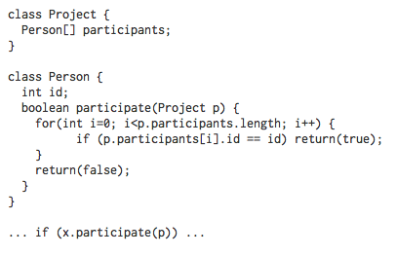
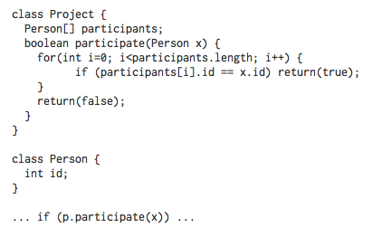
Move Method (another) Example

Slide 37

Feature Envy
A method in a class seems more interest in some other class’s internals than its own
The most common target of the envy is data
E.g., a class repeatedly calls getter and setter methods on some other class
[Strategy pattern is an exception]
Potential refactorings:
Extract method, Move method, Move field

Slide 38

Data Clumps
Bunches of data that hang around together should be made into their own object
Fields in several classes, parameters that are always chained together, etc.
Ask yourself the question: are the others sensible when one is removed?
Potential refactorings:
Extract class, Preserve whole object, Introduce parameter object

Slide 39

Primitive Obsession
Old-timers are reluctant to use small objects for money, strings, intervals, etc.
Instead result in an over-emphasis on primitive objects (e.g., strings, arrays, integers, etc.)
Classes generally provide a simpler and more natural way to directly model things than primitives do
Higher level abstractions clarify code
Potential refactorings:
Replace data value(s) with object, Replace type code with class, Replace type code with state/strategy

Slide 40
Replace Data Value with Object
You have a data item that needs additional data or behavior
Really, try not to start with primitives and add more and more primitives that are conceptually (but not concretely) linked
Instead, turn the data item into an object

Slide 41
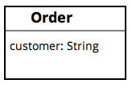
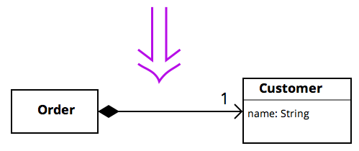
Replace Data Value with Object Example

Slide 42
Replace Type Code with Class
A class has a (numeric) type code that does not affect its behavior
Replace the number with a new class

Slide 43
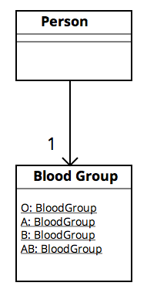
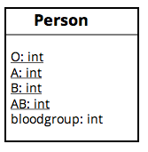

Replace Type Code with Class Example

Slide 44
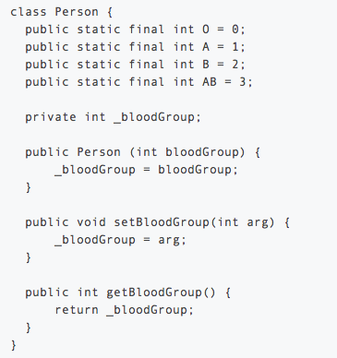
Replace Type with Class: Code Examples

Slide 45
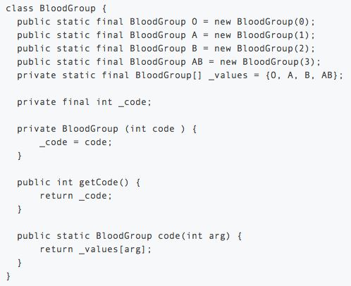
Replace Type with Class: Code Examples (cont.)

Slide 46
Replace Type with Class: Code Examples (cont.)
class Person {
public static final int O = BloodGroup.O.getCode();
public static final int A = BloodGroup.A.getCode();
public static final int B = BloodGroup.B.getCode();
public static final int AB = BloodGroup.AB.getCode();
private BloodGroup _bloodGroup;
public Person (int bloodGroup) {
_bloodGroup = BloodGroup.code(bloodGroup);
}
public int getBloodGroup() {
return _bloodGroup.getCode();
}
public void setBloodGroup(int arg) {
_bloodGroup = BloodGroup.code (arg);
}
}

Slide 47
Replace Type with Class: Code Examples (cont.)
class Person {
...
public int getBloodGroup() {
return _bloodGroup.getCode();
}
public BloodGroup getBloodGroup() {
return _bloodGroup;
}
}
class Person {
...
public Person (int bloodGroup) {
_bloodGroup = BloodGroup.code(bloodGroup);
}
public Person (BloodGroup bloodGroup ) {
_bloodGroup = bloodGroup;
}
}
class Person {
...
public void setBloodGroup(int arg) {
_bloodGroup = BloodGroup.code (arg);
}
public void setBloodGroup(BloodGroup arg) {
_bloodGroup = arg;
}
}

Slide 48
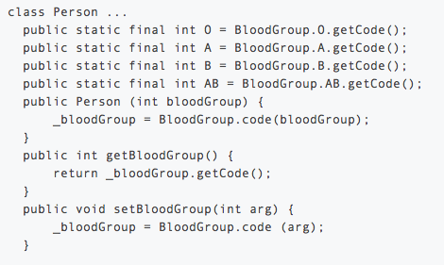
Replace Type with Class: Code Examples (cont.)

Slide 49
Replace Type with Class: Code Examples (cont.)
Now class “person” is like...
class person...
public int getBloodGroupCode(){
return _bloodGroup.getCode();
}
public BloodGroup getBloodGroup(){
return _bloodGroup;
}
public Person (BloodGroup bloodGroup){
_bloodGroup = bloodGroup;
}
public boid setBloodGroup(BloodGroup arg){
_bloodGroup = arg;
}

Slide 50
Replace Type with Class: Code Examples (cont.)
Any more improvements for class “BloodGroup”?

Slide 51
Replace Type Code with State/Strategy
You have a type code that affects the behavior of the class, but you cannot use subclassing
Replace the type code with a state/strategy object

Slide 52
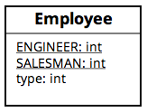

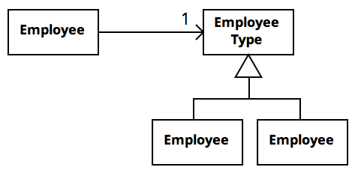
Replace Type Code with State/Strategy Example

Slide 53
Replace Type Code with State/Strategy Example
class Employee {
private EmployeeType type;
private float salary;
private float commission;
...
public void setEmployeeType(EmployeeType type) {
this.type = type;
}
public float salary() {
return salary;
}
...
public float pay() {
return type.pay(this);
}
}
class Engineer extends EmployeeType {
float pay(Employee employee) {
return employee.salary();
}
}
class Salesman extends EmployeeType {
float pay(Employee employee) {
return employee.salary() +
employee.commission();
}
}

Slide 54
Replace Type Code with State/Strategy Example
class Employee {
private EmployeeType type;
private float salary;
private float commission;
...
public void setEmployeeType(EmployeeType type) {
this.type = type;
}
public float salary() {
return salary;
}
...
public float pay() {
return type.pay(this);
}
}
enum EmployeeType {
ENGINEER {
float pay(Employee employee) {
return employee.salary();
}
},
SALESMAN {
float pay(Employee employee) {
return employee.salary() +
employee.commission();
}
};
abstract float pay(Employee employee);
}

Slide 55

Switch statements
Ugh.
Switch statements often end up duplicated across the system
Indicative of lack of OO style and underuse of polymorphism
Special case: a conditional that chooses different behavior based on the type of an object
Potential refactorings:
Extract method, Move method, Replace type code with subclasses, Replace type code with state/strategy, Replace conditional with polymorphism

Slide 56
Replace Conditional with Polymorphism
You have a condition that chooses different behavior depending on the type of object
Move each leg of the conditional to an overriding method in a subclass
Make the original method abstract (why?)
Otherwise, you’re introducing an instance of the Refused Request smell… coming up

Slide 57
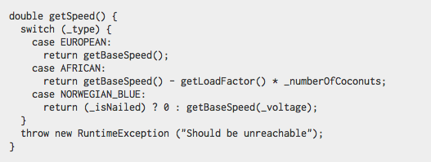
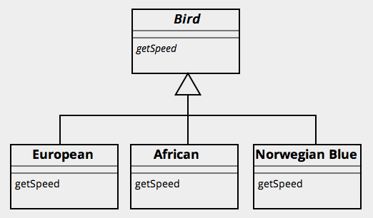

Replace Conditional with Polymorphism Example

Slide 58

Lazy Class
Each class costs something to maintain and understand
We don’t often intentionally make lazy classes, but it can commonly result from downsizing or adding things speculatively
Potential refactorings:
Collapse hierarchy, Inline class

Slide 59
Collapse Hierarchy
Employee
Employee
Salesman

Slide 60

Speculative Generality
We sometimes create hooks and special cases to handle things that aren’t required
E.g., “we might need a method to do X some day”
This is evident when you have generic or abstract code that is not actually needed (at least not yet)
Potential refactorings:
Collapse hierarchy, Rename method, Remove parameter, Inline class

Slide 61
Inline class
Person
officeTelephone
TelephoneNumber
name
areacode
number
getTelephoneNumber
1
getTelephoneNumber
Person
name
areacode
number
getTelephoneNumber

Slide 62

Temporary Field
The inclusion of an instance variable that is only set in some instances
The rest of the time, the field is empty or (worse) contains irrelevant data
This hampers understandability and can lead to accidental errors based on context
Potential refactorings
Extract class, Introduce null object

Slide 63
Introduce Null Object
You have repeated checks for a null values
Ugh. It’s ugly and hard to read.
So replace the null value with a null object!

Slide 64
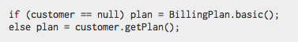

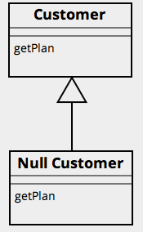
Introduce Null Object Example

Slide 65

Message Chains
Occur when you see a long line of method calls or temporary variables to get some data
E.g., long string of getThis().getThat().getSomething()
Makes the code dependent on the algorithm for navigating the relationships between components
Failure to shelter outside objects from the implementation details
Potential refactorings:
Hide delegate, Extract method, Move method

Slide 66
Hide Delegate
A client is calling a delegate class of an object
Create methods on the server to hide the delegate

Slide 67
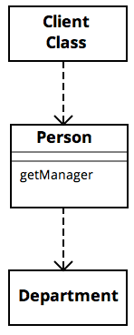
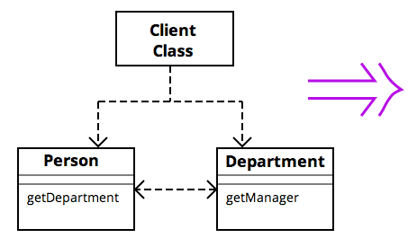
Hide Delegate Example

Slide 68
Some codes
class person{
Department _department;
public Department getDepartment(){
return _department;
}
public void setDepartment(Department arg){
_department = arg;
}
}

Slide 69
Some codes (continued.)
class Department {
private String _chargeCode;
private Person _manager;
public Department (Person manager){
_manager = manager;
}
public Person getManager(){
return _manager;
}
...

Slide 70
Some codes (continued.)
If you want to obtain a manager:
manager = john.getDepartment().getManager();
modification:
public Person getManager(){
return _department.getManager();
}

Slide 71

Middle Man
Delegation is good, and that’s why we make objects
But sometimes, we end up with a design that all an object is doing is passing along calls to another object
For no apparent reason (e.g., an Adapter would be an exception)
There is a fine line between information hiding and delegation overhead.
Potential refactorings:
Remove middle man (duh!), Inline method, Replace delegation with inheritance

Slide 72
Remove Middleman
A class is doing too much simple delegation
Get the client to call the delegate directly
This is the exact dual for Hide Delegate

Slide 73
Remove Middleman Example

Slide 74
Inline Method
A method’s body is just as clear as its name
So put the method’s body into the body of its callers and remove the method

Slide 75
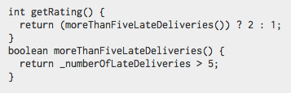

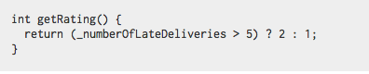
Inline Method Example

Slide 76

Inappropriate Intimacy
Classes sometimes end up delving too much into each others’ private methods and fields
Related: Data Class – classes that have fields and getters and setters but nothing else
Almost assuredly being manipulated in far too much detail by others
Potential refactorings:
Move method, Move field, Change bidirectional association to unidirectional association, Extract class (if classes do in fact have common interests), Hide delegate (allow another class to act as a go-between), Encapsulate collection (for Data Class)

Slide 77
Change Bidirectional Association to Unidirectional
You have a two-way association but one class no longer needs access to the other
So drop the unneeded end of the association

Slide 78
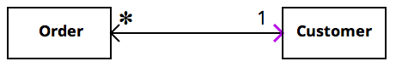

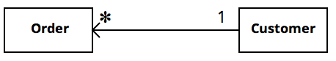
Change Bidirectional Association to Unidirectional

Slide 79
Encapsulate Collection
A method returns a collection
This can be confusing because it may seem to the caller that he can make changes to the collection
Make it return a read-only view and provide add/remove methods

Slide 80
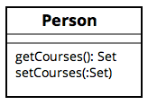
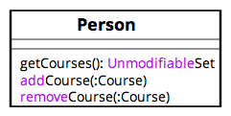

Encapsulate Collection Example

Slide 81

Alternative Classes with Different Interfaces
Classes can be completely different on the outside but end up being the same internally
Basically, you should find the similarities in the two classes, the refactor them to share a common interface
Potential refactorings:
Extract superclass, Unify interfaces with adapter

Slide 82

Refused Bequest
Happens when you inherit code you don’t want
i.e., a child class uses very little of the functionality of some parent (base) class
The worst (strongest smell) here is when the child reimplements the behavior from the parent class
Potential refactorings:
Push down field, Push down method, Replace inheritance with delegation

Slide 83
Replace Inheritance with Delegation
A subclass uses only part of a superclass’s interface or does not want to inherit data
Create a field for the superclass, adjust methods to delegate to the superclass, and remove the subclassing

Slide 84
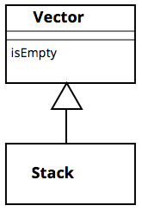
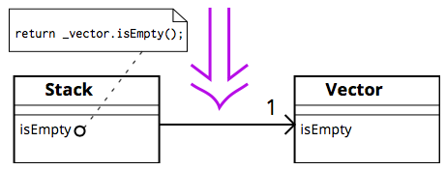
Replace Inheritance with Delegation Example

Slide 85
Questions?

